Slide 1
Amplify
December 4th 2019
Alexia Filler, Ben Kern, Ian Lizarda, Donovan Moini, and Serena Zafiris

Slide 2
Project Description
Amplify is a community music streaming service that will allow users to create and join rooms that host public music playlists using Spotify and YouTube services, similar to platforms like plug.dj and Outloud.
Users will be able to join rooms and add songs of their choice from Spotify or YouTube to the community queue, which will be cycled through in round-robin style between all users’ queued songs.
Amplify will also have features useful to an individual user; the user will be able to import multiple playlists and rotate through those playlists via round-robin style.
Notes:
Ben

Slide 3
Project Goals
To build a fully working app that can be deployed in the Apple App Store and the Google Play Store
To learn about the entire process of mobile application development and what it entails
To create a user-friendly app to help individuals better share and experience music with their friends
To make Eddie Azinge happy
Notes:
Alexia

Slide 4
Project Justification
Why are we interested?
Never made an entire app before
New set of coding tools such as React, Apollo GraphQL
Good way to dive into AWS
Why it this a good use of our abilities?
Pushes the knowledge gained from interaction design further
Culmination of LMUCS curriculum by focusing on both frontend and backend so that we are not only focusing on one aspect of our schooling
What non-CS parts of our LMU curriculum does it use?
Uses design practices beyond interaction design.
Used software such as Photoshop and Illustrator which was learned in my Animation Courses
Used to create UI/UX mockups
Used to design the logo
Notes:
Alexia (bullets 1, 2)
Serena (bullet 3)

Slide 5
How it operates
User opens app
User creates account and provides Spotify login information
User chooses either to create or join a room:
Create
User enters created room. The user now has admin access.
User can invite friends to join their room by providing them with a room code.
User can play music from both spotify and youtube, and add songs to the queue.
Join
User enters room code.
User joins the appropriate room.
User can add songs to the public queue from both Spotify and YouTube.
Notes:
Serena

Slide 6
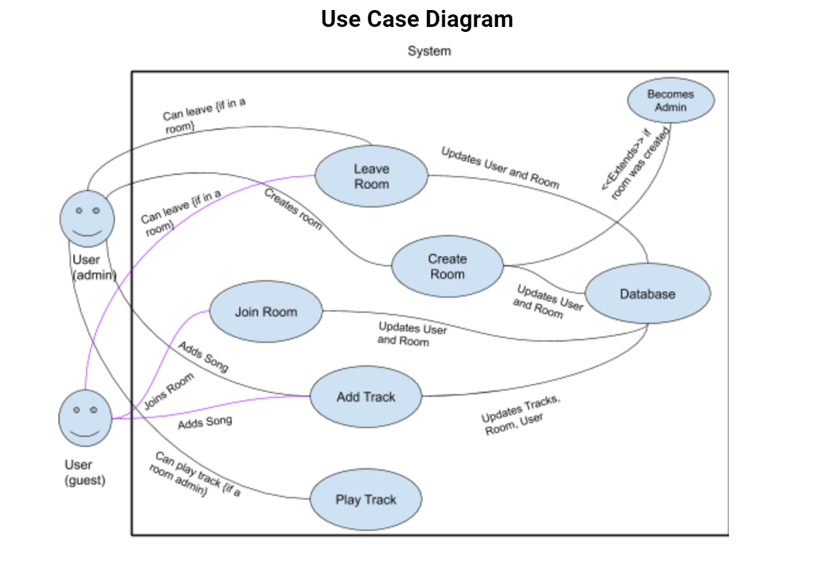
Use Case Diagrams
Notes:
Serena

Slide 7
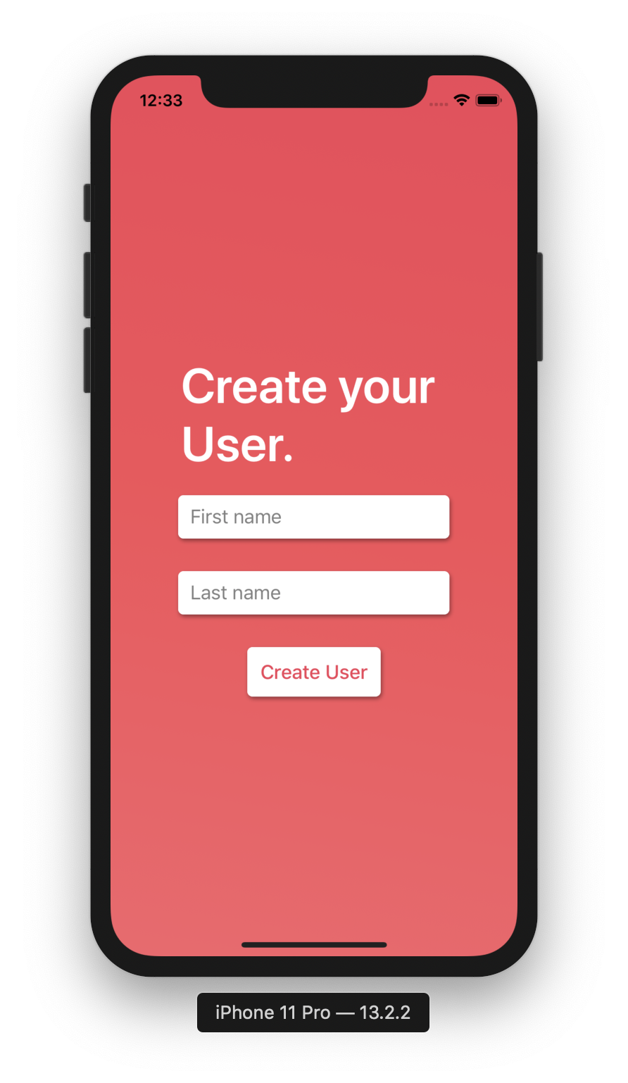
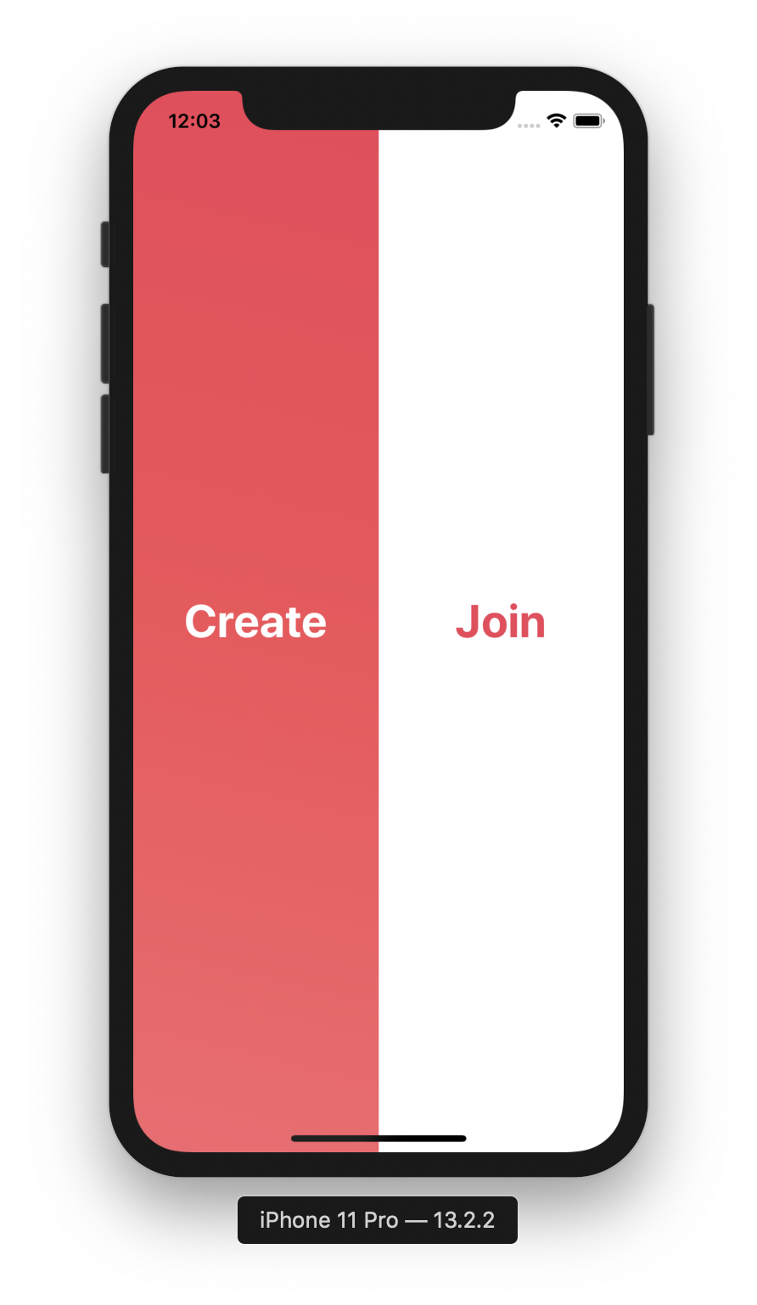
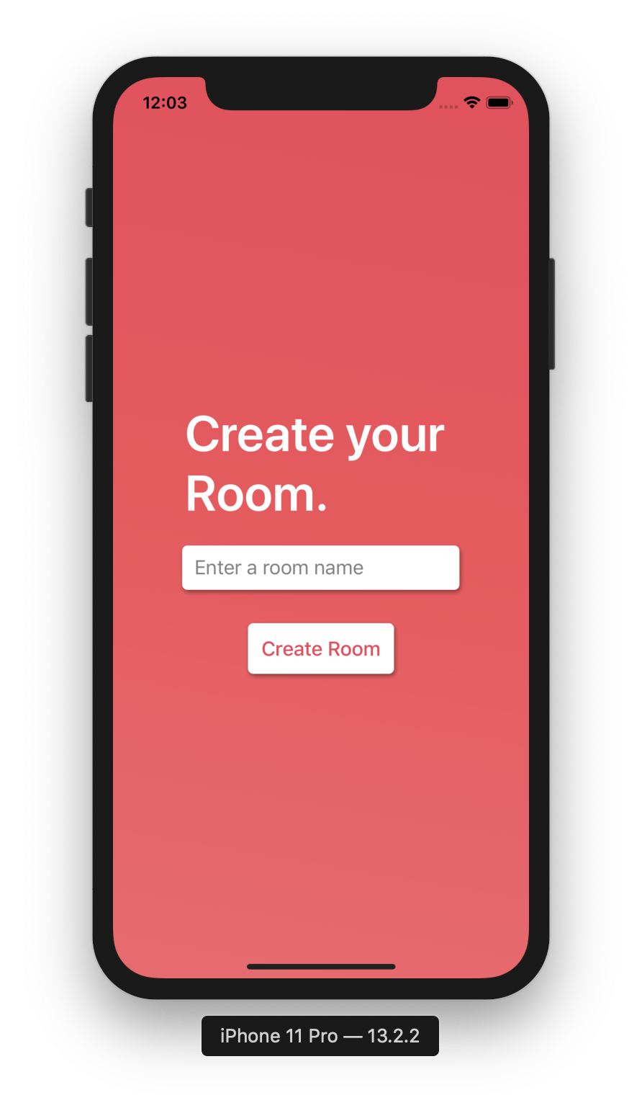
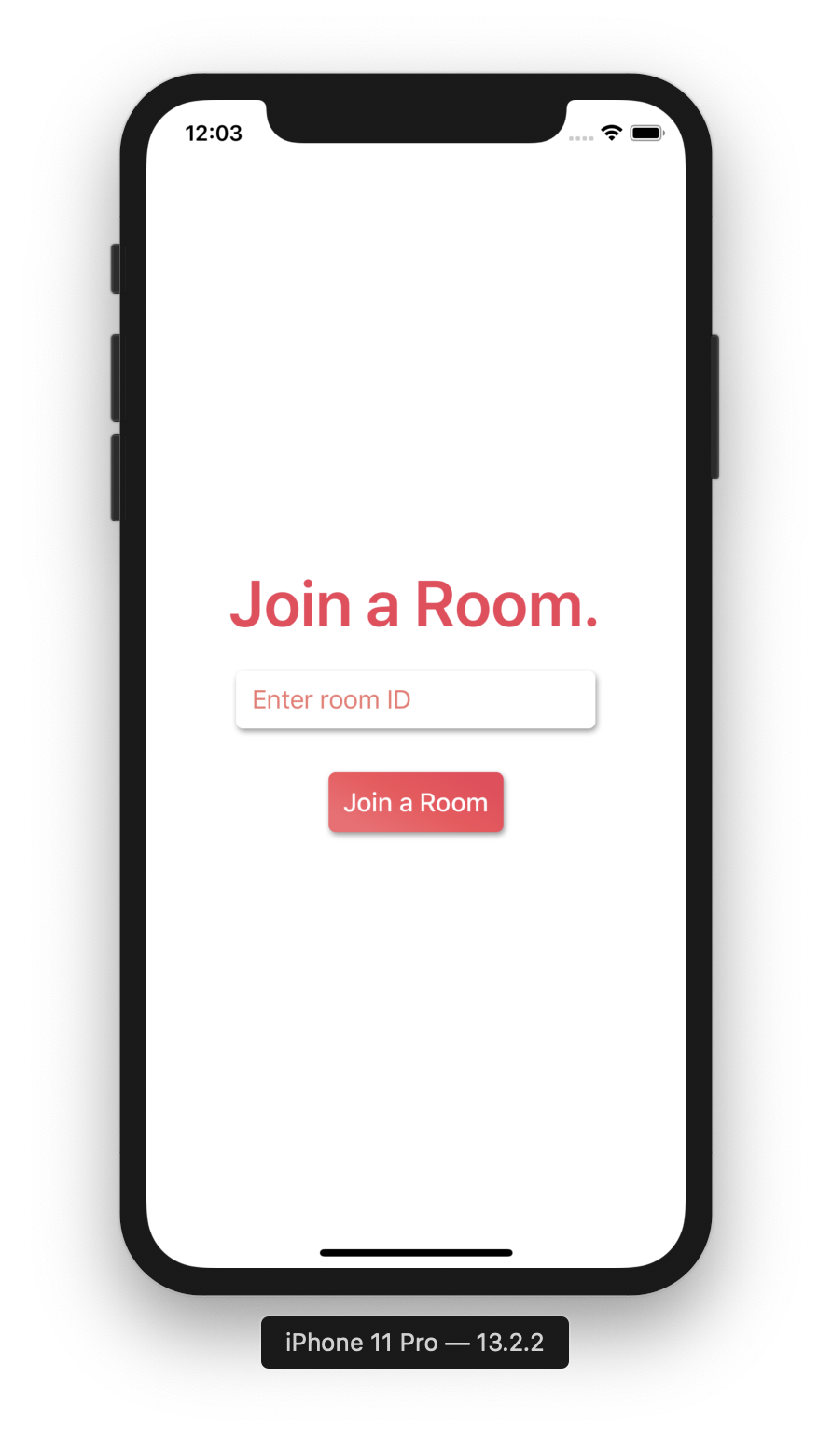
UI Mockups
Notes:
Ian

Slide 8
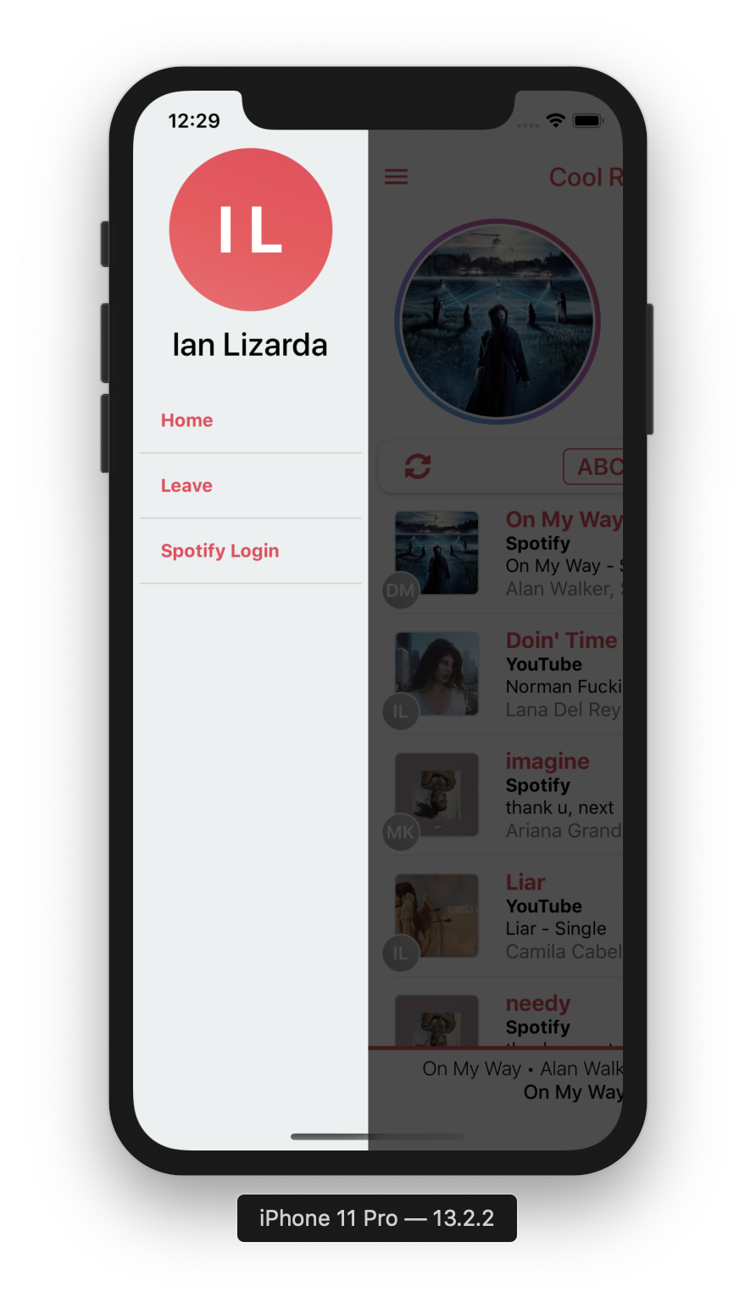
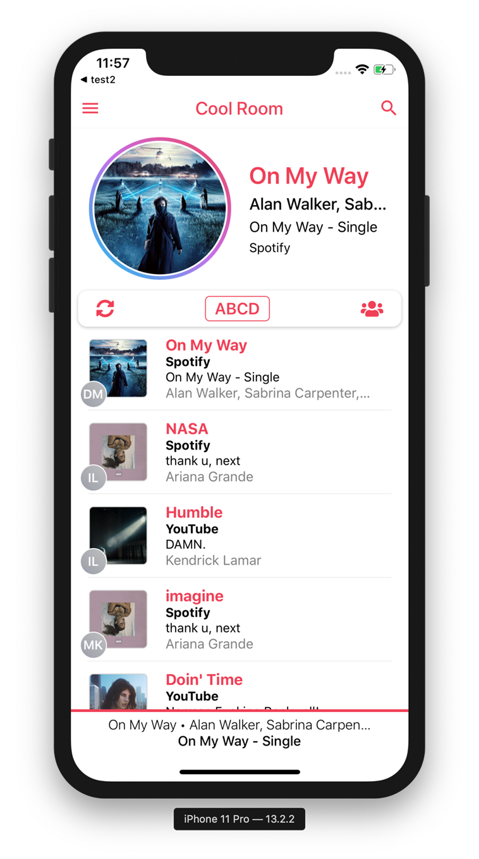
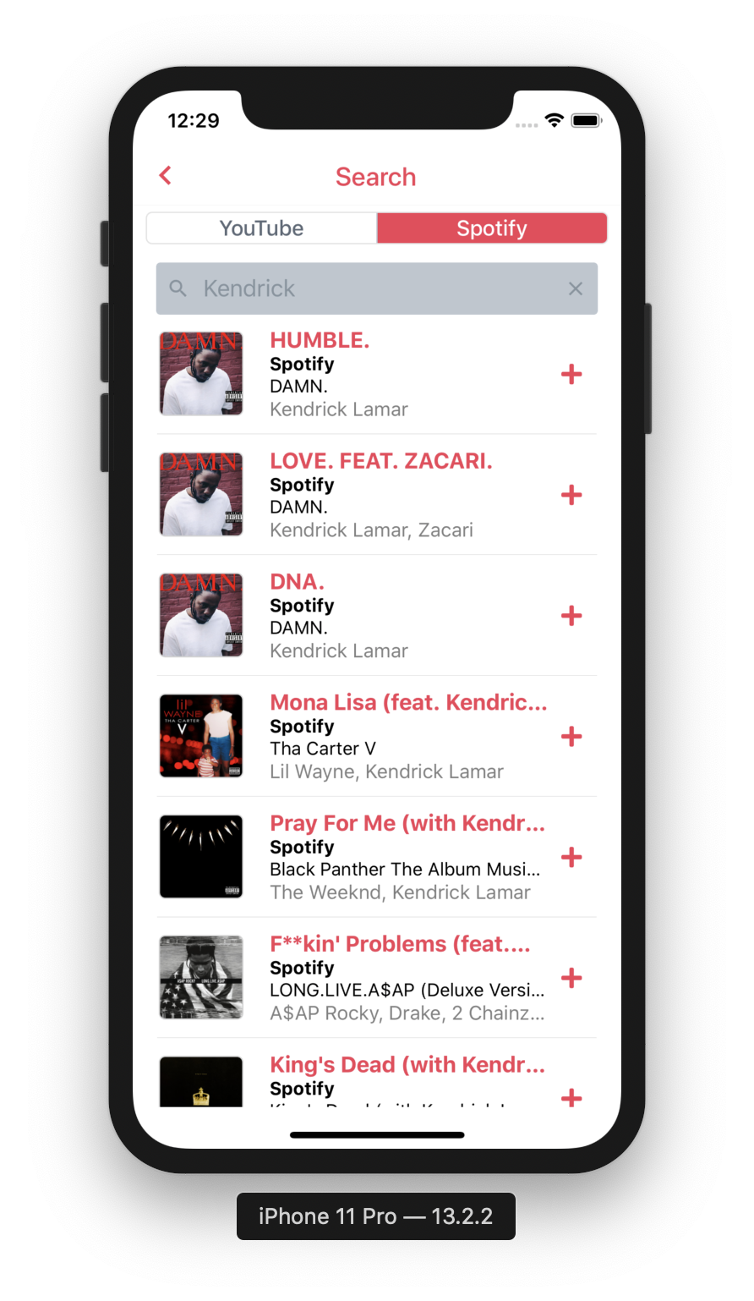
UI Mockups
Notes:
Ian

Slide 9
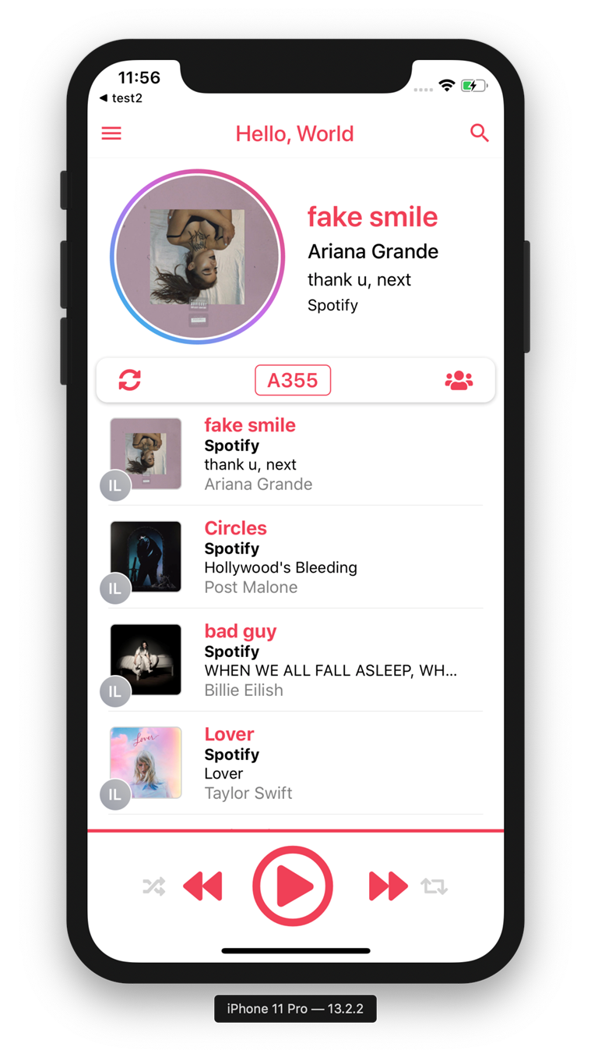
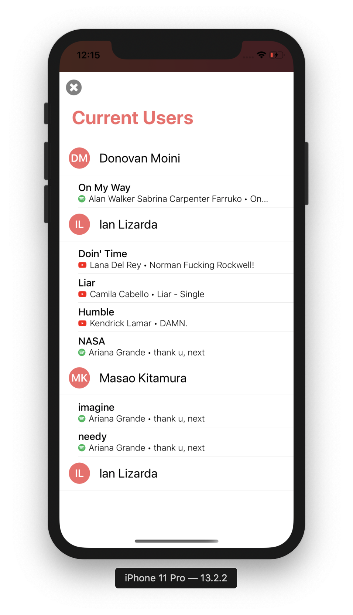
UI Mockups
Notes:
Ian

Slide 10
Detailed Diagrams

Slide 11
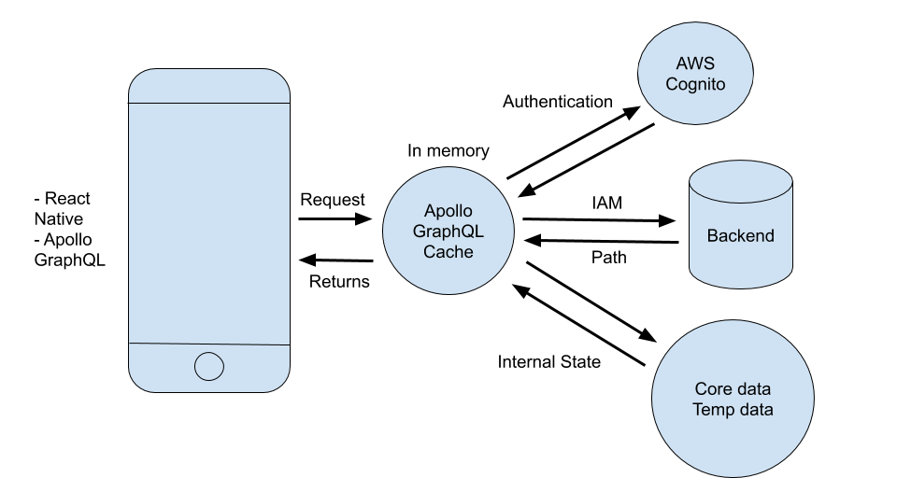
Interaction Flow Diagram
Notes:
Donovan

Slide 12
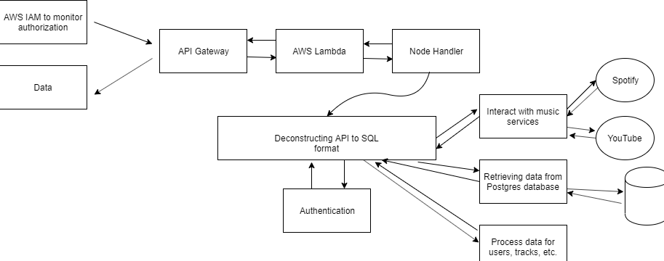
Backend Data Flow Diagram
Retrieving data from DynamoDB
Notes:
Donovan’s sweet sweet baby

Slide 13
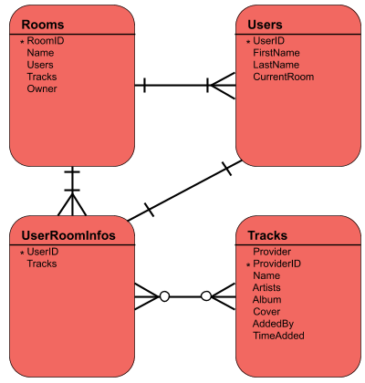
Database Diagram
Notes:
Ben

Slide 14
Demonstration

Slide 15
Project Challenges
Dealing with Amazon
A majority of AWS documentation pages are outdated and/or incredibly confusing
Working with the Android Emulator
Very inconsistent
Working with the YouTube and Spotify APIs
Learning how to use new tools (React, GraphQL)
Notes:
Alexia (let Donovan complain about AWS and Serena about Emulator xoxo)

Slide 16
Thank you for listening

Slide 17
Questions?

